Slide 1
SOF 103
C and C++ Programming
Encapsulation
Inheritance
Access Control

Slide 2
Vision and Mission
Vision
Xiamen University Malaysia aspires to become a university with a distinct global outlook, featuring first-class teaching and research, and embracing cultural diversity.
Mission
To nurture young talents with dignity and wisdom, turning them into fine citizens of the region who will contribute to the prosperity of the people and social progress of Malaysia, China and Southeast Asia.
Compile by Dr. Hew

Slide 3
Encapsulation ?
Encapsulation is an OOP concept which can be defined as binding together the data and the functions that manipulates those data.
Wrapping/Binding them into a single unit helps in keeping them secure from outside access.
Class is an example of encapsulation. If we have created some classes and have data member and member functions then it is an example of encapsulation.

Slide 4
Encapsulation
It performs the operation of data hiding using access modifier/specifier.
It is a way to customize access to different portion of the data.
Some data are hidden behind the access methods and some are open to all.
We can control the access on data by defining the access modifier:
Public : Other classes and functions can access data members and member functions.
Protected : Similar to Private. However it can be accessed by the class which has defined it , any derived(child) classes and friend functions.
Private : It can be accessed Only by the class which has defined it. Function outside the class cannot access data members and member functions. Only the member functions inside the class can access them.

Slide 5
Inheritance ?
继承
Waris
Наследование
الميراث
Meros
мұрагерлік

Slide 6
Inheritance ?
Inheritance is a kind of software reusability in which new classes are created from existing classes by absorbing their attributes and behaviours and overriding these with capabilities the new classes require.

Slide 7

Inheritance ?

Slide 8

Inheritance ?

Slide 9
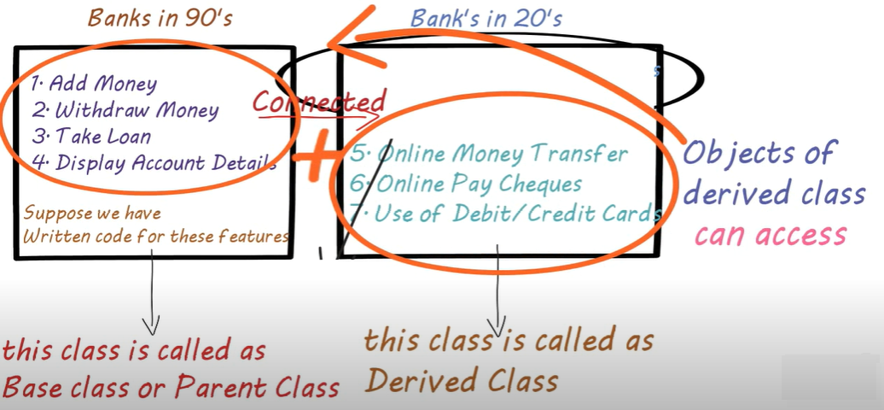

Inheritance ?

Slide 10
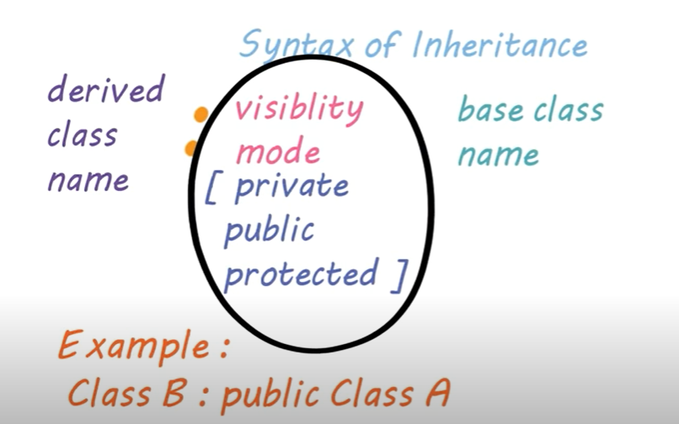
Syntax of Inheritance

Slide 11
Base Classes and Derived Classes
A new class can inherit the data members and methods of a previously defined base class. The new class is referred to as a derived class.
A derived class can add data members and methods of its own, so a derived class can be larger than its base class.
In public inheritance, an object of a derived class can be treated as an object of its corresponding base class.
But the reverse is not true: A base-class object is not also automatically a derived class object.

Slide 12
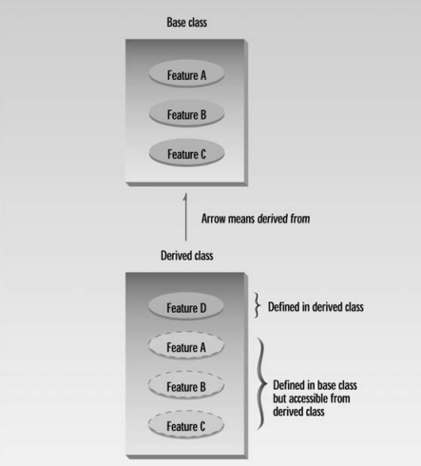
Inheritance Concept

Slide 13
Type of Inheritance
Single Inheritance
Multi level Inheritance
Hierarchical Inheritance
Hybrid Inheritance
Multiple Inheritance

Slide 14
Single Inheritance
Base class
Derived class

Slide 15
Single Inheritance
There are only two classes: class B and class D.
class B{
int data;
public:
void getData()
{
cout<<"Enter a number: "; //This is Class B
cin>>data;
}
void displayData()
{
cout<<"The number that you entered is "<<data<<endl;
}
};

Slide 16
Cont…
This is a derived class, D. After the class D inherited class B, the object of Class D will be able to access the function in Class B.
class D:public B
{
void showInfo()
{
cout<<"Welcome to class Derived class D "<<endl;
}
};

Slide 17
Cont…
This is the main function that utilizes the derived class D
int main()
{
D d1;
d1.getData();
d1.displayData();
d1.showInfo();
}

Slide 18
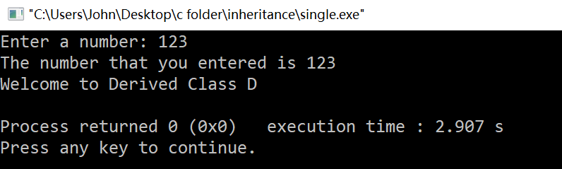
Output of the main program that utilizes the class D

Slide 19
Multi Level Inheritance
Base class
Derived 1 class
Derived 2 class

Slide 20
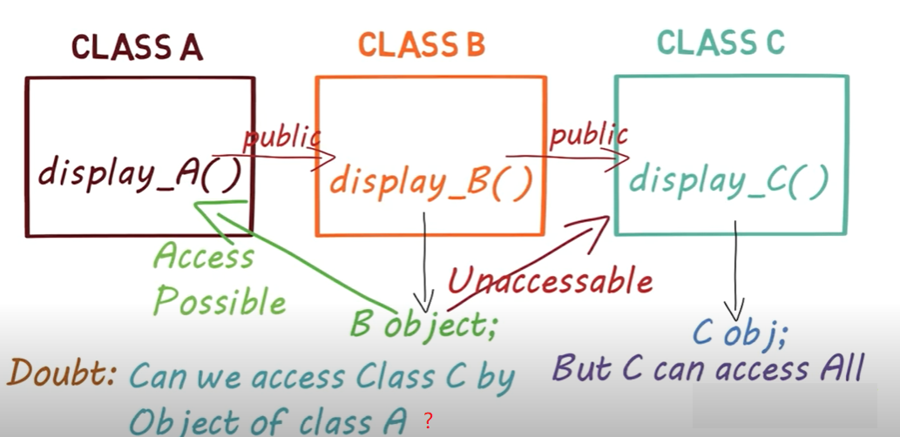
Multi Level Inheritance
We can use any number of classes in this kind of inheritance. Supposed we create three classes, A, B and C as below:

Slide 21
Multi Level Inheritance
class B{
int data;
public:
void getData()
{
cout<<"Enter a number: "; //This is Class B
cin>>data;
}
void displayData()
{
cout<<"The number that you entered is "<<data<<endl;
}
};

Slide 22
Cont…
This is a derived classes, D and D1. After the class D1 inherited class D, the object of Class D1 will be able to access the functions in Class B and D.
class D:public B // This is class D
{
void showInfo()
{
cout<<"Welcome to class Derived class D "<<endl;
}
};
class D1:public D // This is class D1
{
void showInfoD1()
{
cout<<"Welcome to class Derived class D1 "<<endl;
}
};

Slide 23
Cont…
This is the main function that utilizes the derived class D
int main()
{
D1 objD1;
objD1.getData(); // calling function of class B
objD1.displayData(); // calling function of class B
objD1.showInfo(); // calling function of class D
objD1.showInfoD1(); // calling function of class D1
}

Slide 24
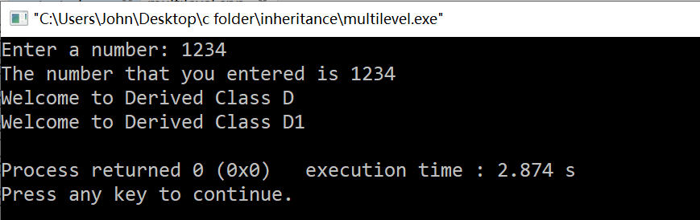
Output of the main program that utilizes the class D1

Slide 25
Multiple Inheritance
Base class 1
Base class 2
Derived class

Slide 26
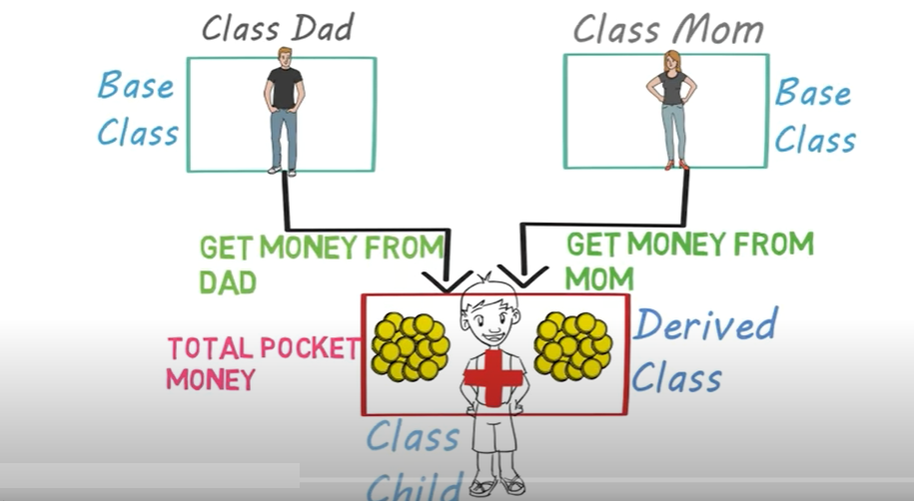
Multiple Inheritance
The structure of Multiple inheritance is as below:

Slide 27


The syntax of Multiple Inheritance

Slide 28
Multiple Inheritance
class Dad{ //This is class Dad
protected:
int moneyDad;
public:
void getMoneyDad()
{
cout<<"Enter money received from Dad: ";
cin>>moneyDad;
}
void displayMoneyDad()
{
cout<<"Money received from Dad is "<<moneyDad<<endl;
}
};

Slide 29
Cont…
class Mom{ //This is class Mom
protected:
int moneyMom;
public:
void getMoneyMom()
{
cout<<"Enter money received from Mom: ";
cin>>moneyMom;
}
void displayMoneyMom()
{
cout<<"Money received from Mom is "<<moneyMom<<endl;
}
};

Slide 30
Cont…
//This is class Child
class Child:public Dad, public Mom
{
public:
int totalMoney;
void showTotalMoney()
{
totalMoney = moneyDad + moneyMom;
cout<<"The total money received from parents: "<<totalMoney<<endl;
}
};

Slide 31
Cont…
This is the main function that utilizes the derived class Child
int main()
{
Child obj1;
obj1.getMoneyDad(); //calling function of class Dad
obj1.getMoneyMom(); //calling function of class Mom
obj1.displayMoneyDad(); //calling function of class Dad
obj1.displayMoneyMom(); //calling function of class Mom
obj1.showTotalMoney(); //calling function of class Child
}

Slide 32
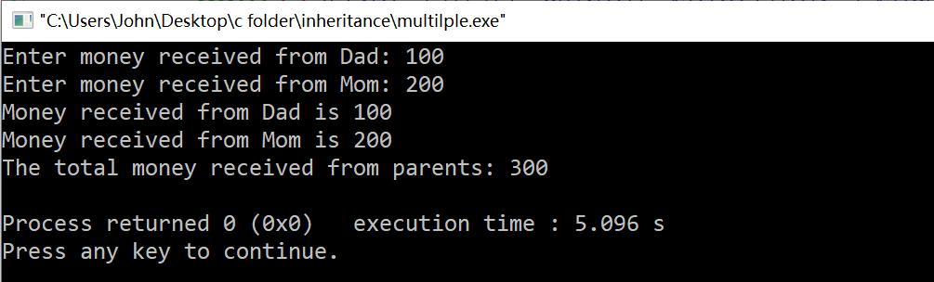
Output of the main program that utilizes the class D1

Slide 33
Hierarchical Inheritance
Base class
Derived 1 class
Derived 2 class
Derived 3 class

Slide 34
When we need the Hierarchical Inheritance?
Suppose we are making a database for a university faculty. So we create three classes: Dean, Lecturer, Student.
These three classes have many similar things such as name, gender, age, weight, height and so on. For this demo we chosen three as listed below:
Name
Gender
Age
We’ll use Hierarchical Inheritance if we do not want to write the similar codes for common things.
We create another class called Common.

Slide 35
Hierarchical Inheritance
class Common{
string name;
string gender;
int age;
public:
void getInfo()
{
cout<<"Enter your name: ";
cin>>name;
cout<<"Enter your gender: ";
cin>>gender;
cout<<"Enter your age: ";
cin>>age;
}
void displayInfo()
{
cout<<"Name : "<<name<<endl;
cout<<"Gender : "<<gender<<endl;
cout<<"Age : "<<age<<endl;
}
};
//This is class Common

Slide 36
Cont…
class Dean:public Common
{
int salary;
public:
void getSalary()
{
cout<<"Enter Dean Monthly Salary: ";
cin>>salary;
}
void displaySalary()
{
cout<<"Dean Monthly Salary is "<<salary<<endl;
}
};
//This is class Dean

Slide 37
Cont…
class Lecturer:public Common
{
int salary;
public:
void getSalary()
{
cout<<"Enter Lecturer Monthly Salary: ";
cin>>salary;
}
void displaySalary()
{
cout<<"Lecturer Monthly Salary is "<<salary<<endl;
}
};
//This is class Lecturer

Slide 38
Cont…
class Student:public Common
{
int mark;
public:
void getMark()
{
cout<<"Enter Student Mark: ";
cin>>mark;
}
void displayMark()
{
cout<<"Student Mark is "<<mark<<endl;
}
};
//This is class Student

Slide 39
Cont…
This is the main function that utilizes the derived class Dean
int main()
{
Dean obj1; //create an object obj1 of class Dean
obj1.getInfo(); //calling function of class Common
obj1.getSalary(); //calling function of class Dean
obj1.displayInfo(); //calling function of class Common
obj1.displaySalary(); //calling function of class Dean
return 0;
}

Slide 40

Output of the main program that utilizes the class Dean

Slide 41
Hybrid Inheritance?
Sometime we need to apply two or more types of inheritance, and it is called as Hybrid Inheritance.

Slide 42
Hybrid Inheritance
Base class
Derived1 class
Derived 2 class
Derived 3 class

Slide 43
Hybrid Inheritance
class Man{
protected:
int income;
public:
void getIncome(int inc)
{
income=inc;
}
};
class TaxOnIncome:public Man
{
protected:
int incomeTax;
public:
void calculateTax()
{
incomeTax=0.2*income;
}
};
//This is class Man
//This is class TaxOnIncome

Slide 44
Cont…
class CarTax
{
protected:
int carTax;
public:
void getCarTax(int c)
{
carTax=c;
}
};
class TotalTax:public CarTax, public TaxOnIncome
{
int total;
public:
void totalTax()
{
total = incomeTax + carTax;
cout<<"\n Income ="<<income<<endl;
cout<<"\n Income Tax="<<incomeTax<<endl;
cout<<"\n Car Tax ="<<carTax<<endl;
cout<<"\n Total tax ="<<total<<endl;
}
};
//This is class CarTax
//This is class TotalTax

Slide 45
Cont…
int main()
{
TotalTax obj1; //create an object obj1 of class TotalTax
obj1.getIncome(50000); //calling function of class Man
obj1.getCarTax(2000); //calling function of class CarTax
obj1.calculateTax(); //calling function of class TaxOnIncome
obj1.totalTax(); //calling function of class TotalTax
return 0;
}

Slide 46
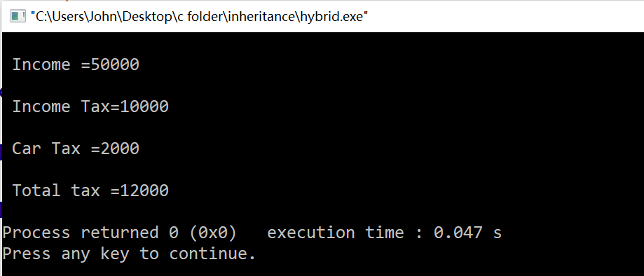
Output of the main program that utilizes the class TotalTax

Slide 47
Access Specifiers
There are three types of access specifiers:
private
protected
public
Supposed we have two classes, B and D. If we want class D inherit the class B. We may write the code as below:
class D: private B
class D: protected B
class D: public B
Class B
Class D

Slide 48
class D: private B
When we use private access specifier, everything of class B becomes private for class D.
When we make an object for class D, the object of class D cannot access private member. However the functions of class D can access functions of class B.
Class B
Class D
private:
Variables
public:
Functions
private:
Variables
public:
Functions
private
connected

Slide 49
class D: private B (example)
#include<iostream>
using namespace std;
class B{
int data;
public:
void getData()
{
cout<<"Enter a number: ";
cin>>data;
}
void displayData()
{
cout<<"The number that you entered is "<<data<<endl;
}
};
class D:private B
{
public:
void showInfo()
{
cout<<"Welcome to Derived Class D"<<endl;
}
};
int main()
{
D d1;
d1.showInfo();
return 0;
}
int main()
{
D d1;
d1.getData();
d1.displayData();
return 0;
}

Slide 50
class D: protected B
When we use protected access specifier, it converts public into protected for class D. However private remains private.
When we make an object for class D, the object of class D cannot access protected member. However the functions of class D can access functions of class B.
Class B
Class D
private:
Variables
public: protected
Functions
private:
Variables
public:
Functions
protected
connected

Slide 51
class D: protected B (example)
#include<iostream>
using namespace std;
class B{
int data;
public:
void getData()
{
cout<<"Enter a number: ";
cin>>data;
}
void displayData()
{
cout<<"The number that you entered is "<<data<<endl;
}
};
class D:protected B
{
public:
void showInfo()
{
cout<<"Welcome to Derived Class D"<<endl;
}
};
int main()
{
D d1;
d1.showInfo();
return 0;
}
int main()
{
D d1;
d1.getData();
d1.displayData();
return 0;
}

Slide 52
Example of Single Inheritance
There are only two classes: Student class and GraduateStudent class.

Slide 53
Base Classes and Derived Classes
A derived class cannot access the private members of its base class.
A derived class can access the public and protected members of its base class, e.g.,
  We have a class Student from previous topic. Next, we create a class named GraduateStudent that inherits the data and methods of class Student. The class Student is the base class and the class GraduateStudent is the derived class.
Student
(Base Class)
derived from
GraduateStudent
(Derived Class)

Slide 54
Syntax of derived class declaration
class <derivedclassname> : public <baseclassname>
{
public:
<function prototypes>;
private:
<list of private members/variables>;
};

Slide 55
Example of class Inheritance
class Student
public:
Student();
setName();
printName();
setMark();
getMark();
Base class
private:
name;
mark;
inherits from
class GraduateStudent
public:
GraduateStudent();
setSemester();
getSemester();
Derived class
private:
Semester;

Slide 56
Example of base class and derived class
#include<iostream>
#include<string>
using namespace std;
class Student{
string name;
int mark;
public:
Student(string, int);
void setName(string);
void printName();
void setMark(int);
int getMark();
};
This is a base class Student declaration.

Slide 57
Cont…
Student::Student(string s, int m)
{
setName(s);
setMark(m);
}
void Student::setName(string sn)
{
name=sn;
}
void Student::printName()
{
cout<<name;
}
void Student::setMark(int m)
{
mark=m;
}
int Student::getMark()
{
return mark;
}
This is the member function definitions of the base class Student.

Slide 58
Cont…
class GraduateStudent:public Student{
private:
int semester;
public:
GraduateStudent(string, int,int);
void setSemester(int);
int getSemester();
};
This is a derived class GraduateStudent declaration.
It is derived from the base class Student we have seen in previous topic.

Slide 59
Cont…
GraduateStudent::GraduateStudent(string s, int m, int sem):Student(s,m)
{
setSemester(sem);
}
void GraduateStudent::setSemester(int sem)
{
semester =sem;
}
int GraduateStudent::getSemester()
{
return semester;
}
This is the member function definitions of the derived class GraduateStudent.
Take note of the constructor where the base-class constructor is also called.

Slide 60
Cont…
int main(){
GraduateStudent gStudent("Thomas",70,2);
cout<<"The graduate student name is ";
gStudent.printName();
cout<<".\n";
cout<<"Mark = "<<gStudent.getMark()<<endl;
cout<<"Semester = "<<gStudent.getSemester()<<endl;
gStudent.setMark(75);
gStudent.setSemester(3);
cout<<"After the change, mark = "<<gStudent.getMark()<<endl;
cout<<"After the change, semester = "<<gStudent.getSemester()<<endl;
return 0;
}
This is the main function that utilizes the derived class GraduateStudent.

Slide 61
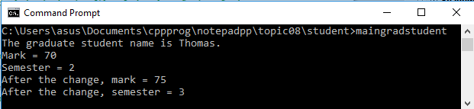
Output of the main program that utilizes the class GraduateStudent

Slide 62
protected Members
A base class’s public members are accessible by all functions in the program.
A base class’s private members are accessible only by member functions and friends of the base class.
A base class’s protected members may be accessed only by members and friends of the base class and by members and friends of derived classes.
Derived class members can refer to public and protected members of the base class simply by using the member names.

Slide 63
Example of using protected member
This header file is modified from the base class Student.
protected:
string name;
int mark;
Note that the
data members
are protected
instead of
private.

Slide 64
Example of using protected member (Continued)
class GraduateStudent:public Student{
private:
int semester;
public:
GraduateStudent(string, int,int);
void setSemester(int);
int getSemester() const;
void printStudentInfo();
};
We modify the previous derived class GraduateStudent by adding
a member function printStudentInfo() that directly access
the member functions of base class Student

Slide 65
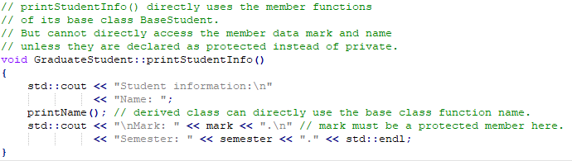
Example of using protected member (Continued)
Insert this code after the int GraduateStudent::getSemester() function.
This is the additional code inserted into the original derived
class GraduateStudent. This part of the code declares
the member function definition for printStudentInfo().
Note the protected member mark can be directly accessed by
the derived class GraduateStudent because it is declared as protected in the base class BaseStudent.
It will be an error if the member mark is declared as a private member and
derived class attempts to access the private member mark.

Slide 66
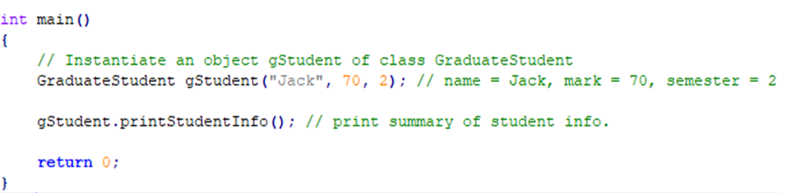
Example of using protected member (Continued)
This is the main function that utilizes
the modified class GraduateStudent.

Slide 67
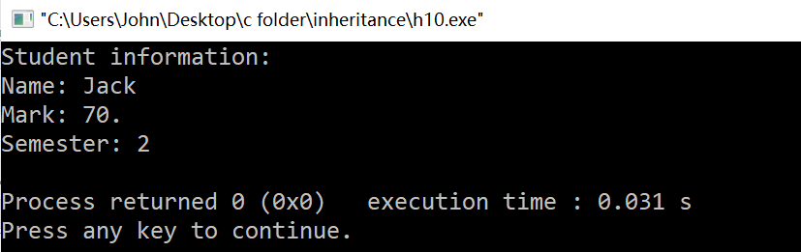
Output of the protected member example

Slide 68
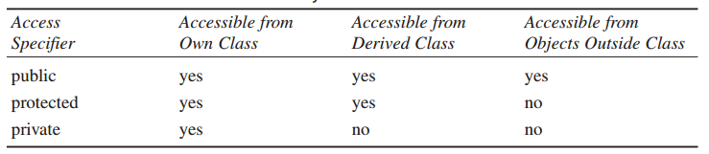
Access Control and Inheritance
In order to implement Inheritance, the data members in the base class should be made protected rather than private.

Slide 69
Why Inheritance?
Using Inheritance to new classes is so simple:
  Save time and enhance consistency.
  Create the function deemed in child (derived) class.

Slide 70
Why Inheritance Should be Used? (Example)
Suppose we have three characters:
  MathsTeacher
  Footballer
  Businessman
Since all three characters are persons, they can walk and talk
They also have some special skills, ie, a MathsTeacher can teach Maths, A Footballer can play football, and a Businessman can run a business.

Slide 71

Cont…
If we create individual classes:
    MathsTeacher Footballer Businessman
In each of the classes, you would be copying the same code for walk and talk for each character.
If you want to add a new feature - eat, you need to implement the same code for each character: which may be error prone and inefficient.

Slide 72
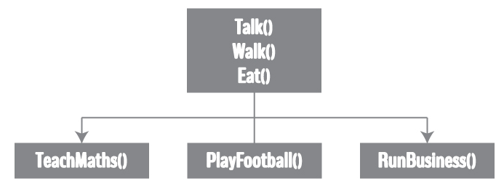
Cont…
Using inheritance:
Using inheritance, now you don't implement the same code for walk and talk for each class. You just need to inherit them.
This makes your code cleaner, understandable and extendable.
Note: each class should satisfy the condition whether it “is a” base class or not.

Slide 73
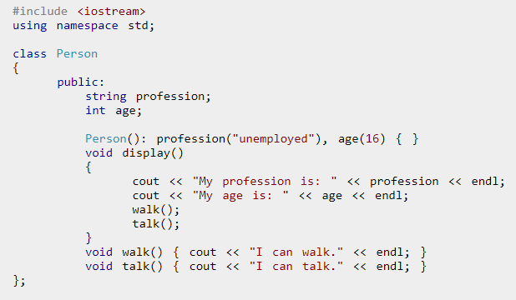
Cont…

Slide 74
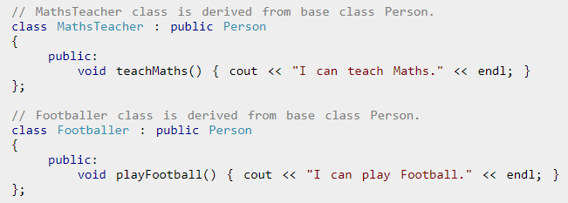

Slide 75
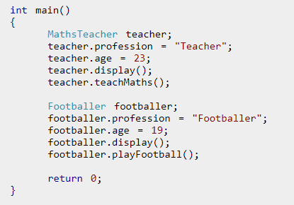
Cont…

Slide 76
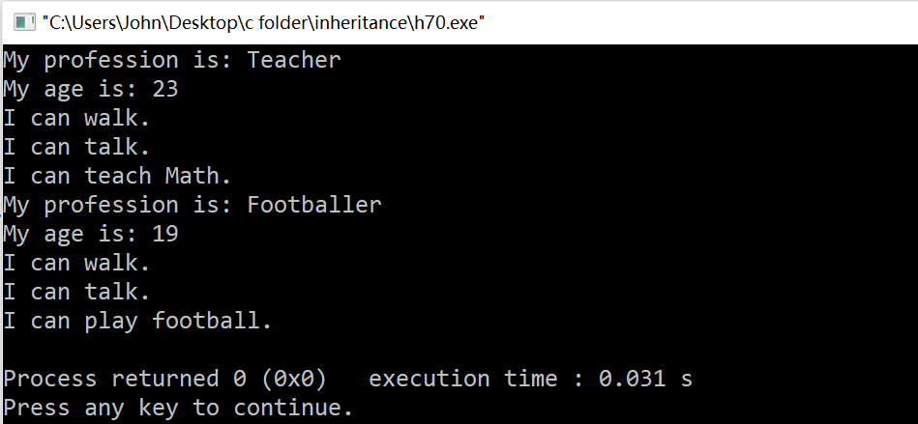
Output of the inheritance example

Slide 77
References
Problem Solving with C++ (10th Edition), Walter Savitch, Addison Wesley, 2018
https://www.programiz.com/cpp-programming/inheritance
Turbo C programming for the PC, Robert Lafore
Dr.Kamran’s notes
https://www.youtube.com/c/Codearchery

